Slide 2
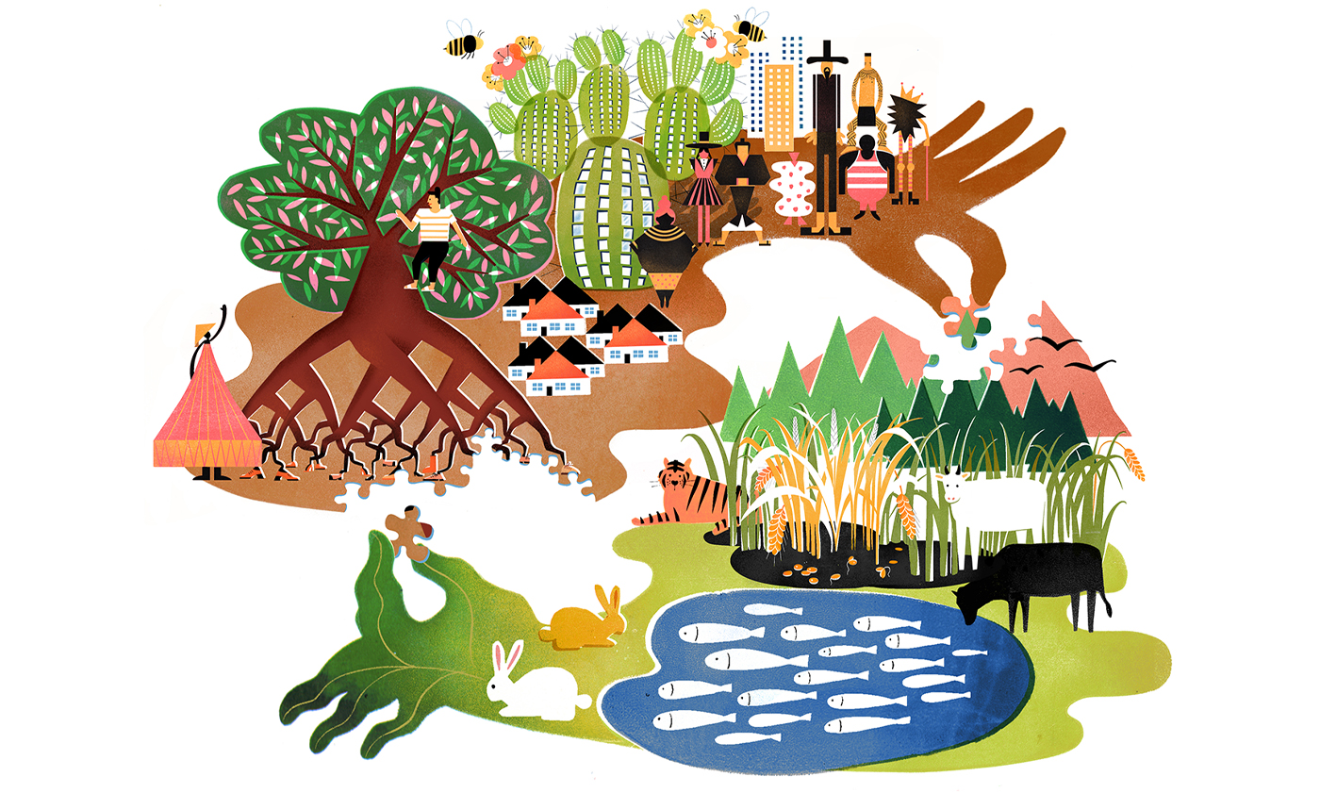

Slide 3
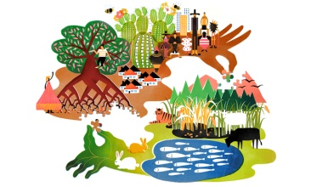
Ecosystems: Concept, Structure and Functions of Ecosystems

Slide 4
Concept of an Ecosystem
Living organisms cannot live isolated from their non-living environment be­cause the latter provides materials and energy for the survival of the former i.e. there is interaction between a biotic community and its environment to produce a stable system; a natural self-sufficient unit which is known as an ecosystem.
An ecosystem is, therefore, defined as a natural functional ecological unit com­prising of living organisms (biotic community) and their non-living (abiotic or physio chemical) environment that interact to form a stable self-supporting sys­tem. A pond, lake, desert, grassland, meadow, forest etc. are common examples of ecosystems.

Slide 5
Structure and Function of an Ecosystem

